Slide 1
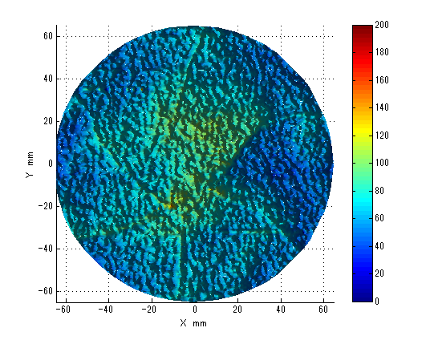
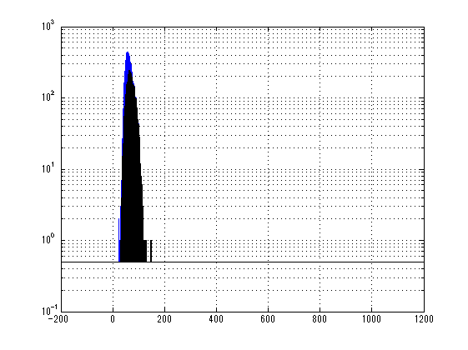
#7 S1
abs = 65.1ppm/cm
std = 14.9ppm/cm

Slide 2
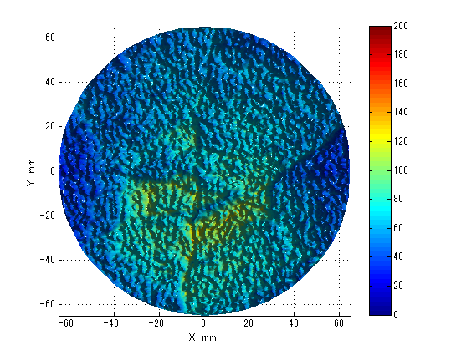
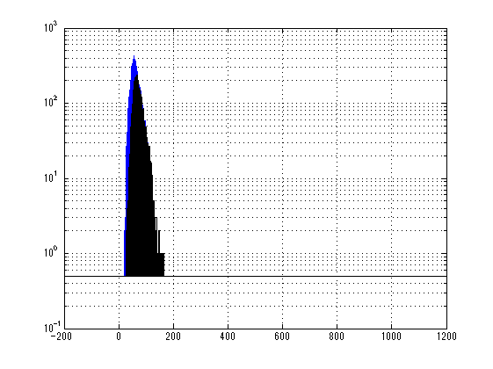
#7 S2
abs = 62.2ppm/cm
std = 16.6ppm/cm

Slide 3
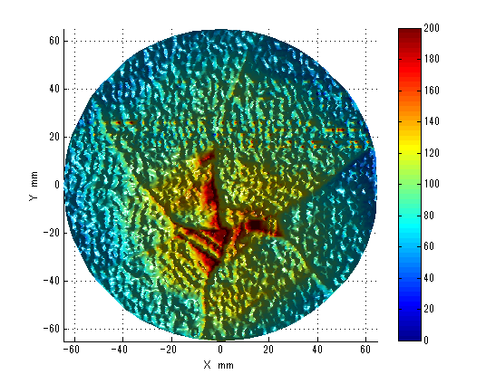
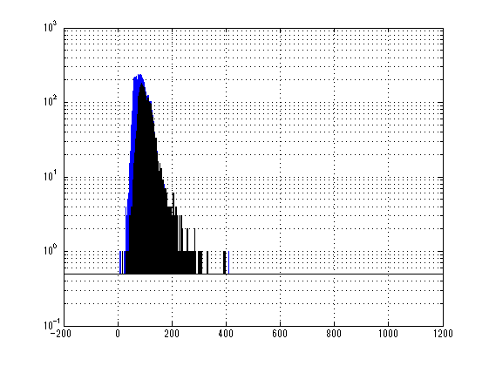
#7 S3
abs = 91.2ppm/cm
std = 28.7ppm/cm

